Slide 1
Active listening
Prepared by Dr. T. Sunand Emmanuel
2021-22 ECE-F and EEE

Slide 2
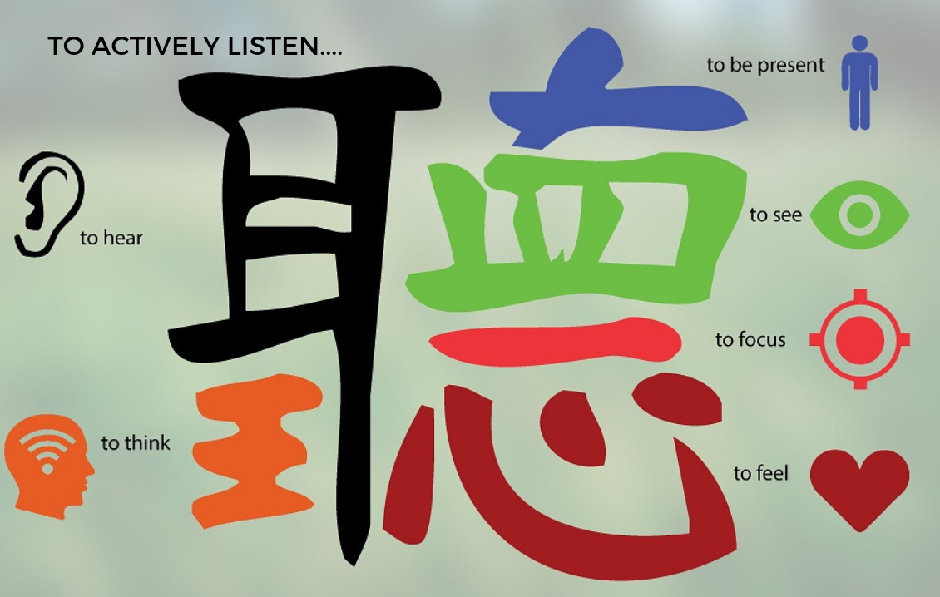
Chinese definition of listening

Slide 3
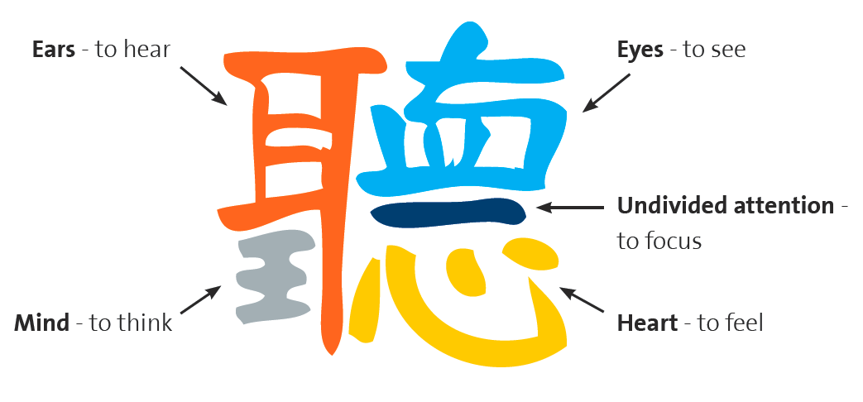

Slide 4
International Listening Association (ILA)
ACTIVE LISTENING
In 1996 the International Listening Association (ILA) approved the following definition: Listening: the process of receiving, constructing meaning from, and responding to spoken and/or nonverbal messages (Purdy & Borisoff, 1997:6).

Slide 5
Hearing: The natural ability to recognize sounds through ears by catching vibrations is called the hearing.
Listening: It is the process of sincerely hearing interpreting and responding to the speaker.

Slide 6
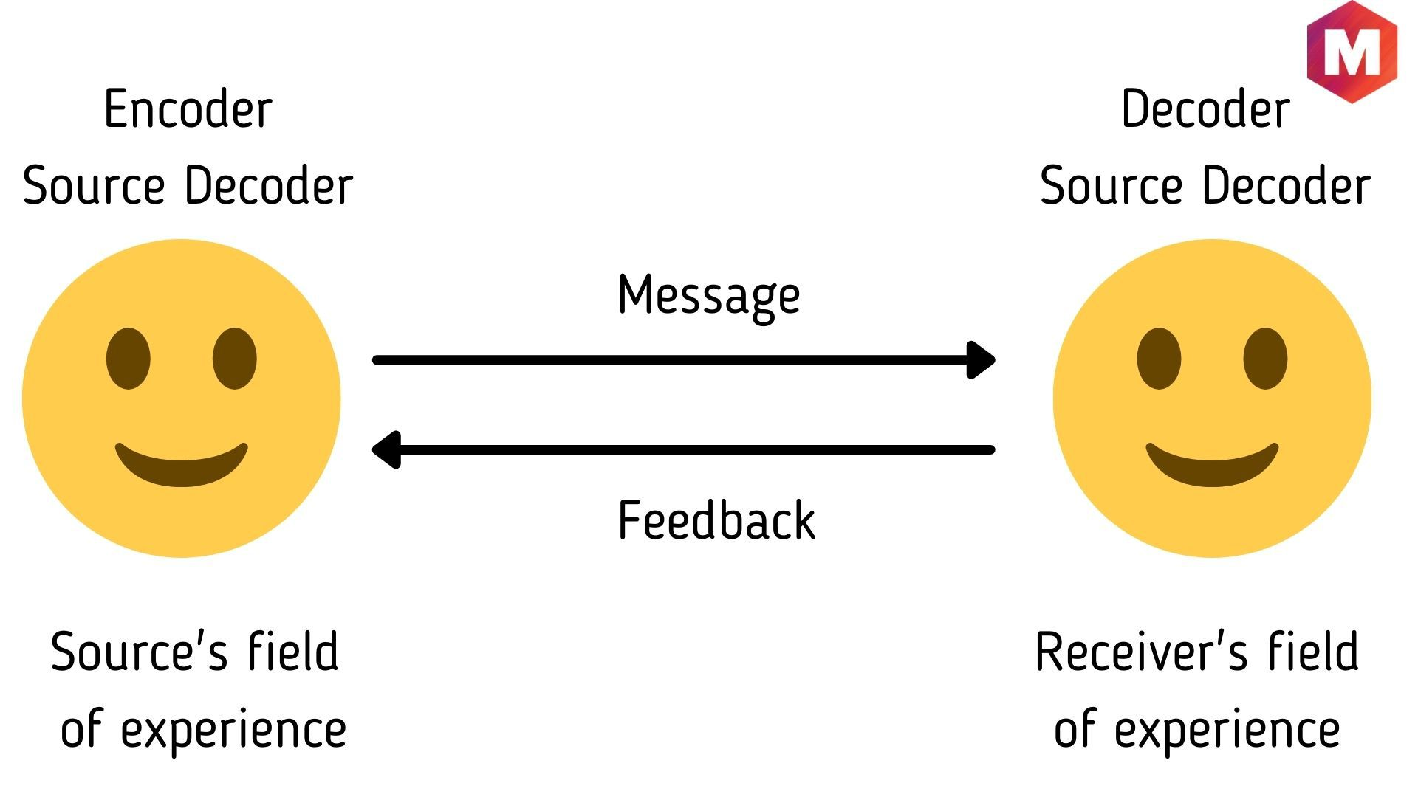
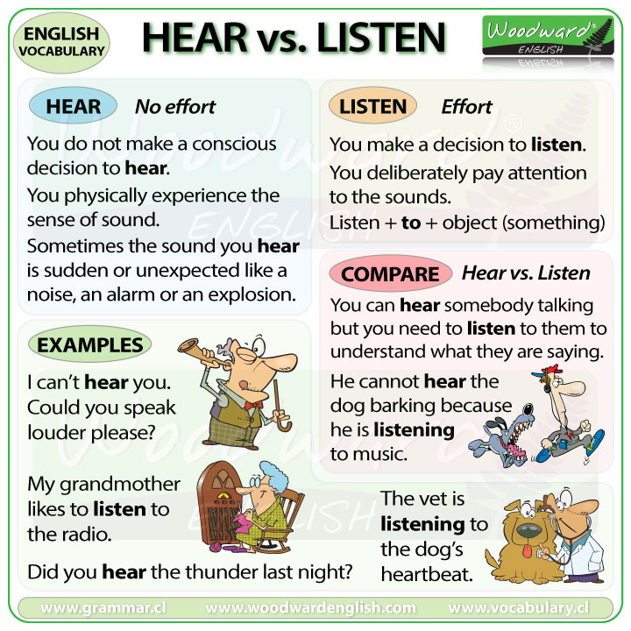
Hearing versus listening

Slide 7
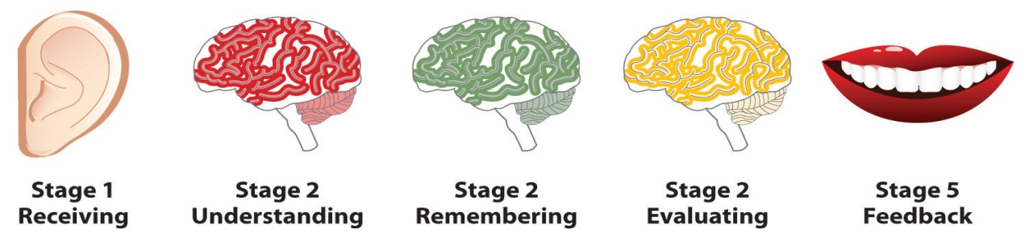
STEPS IN THE LISTENING PROCESS

Slide 8
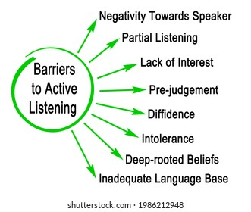
BARRIERS TO LISTENING

Slide 9
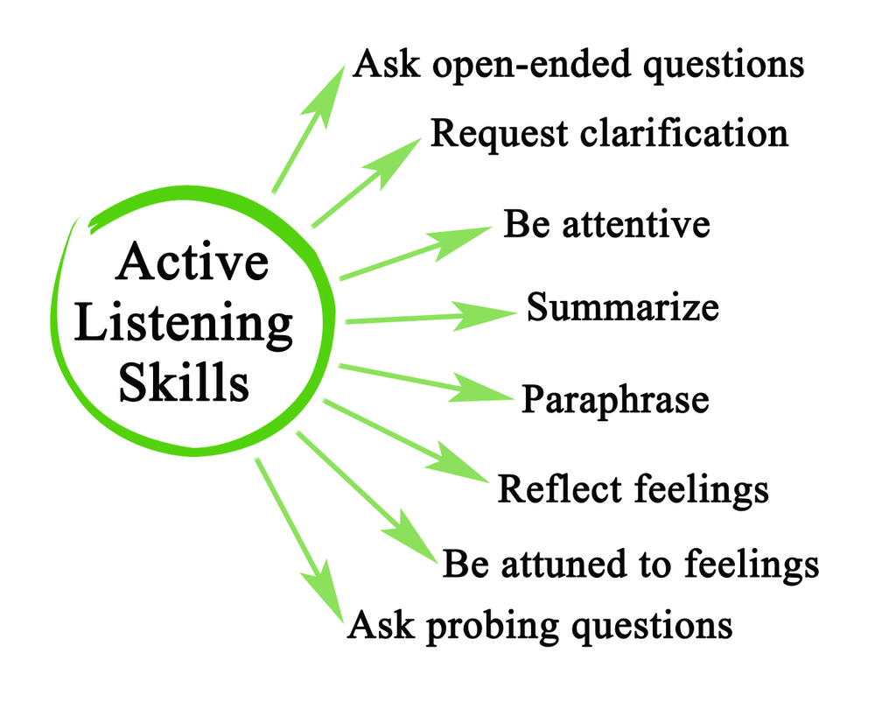
STEPS OF EFFECTIVE ACTIVE LISTENING

Slide 10
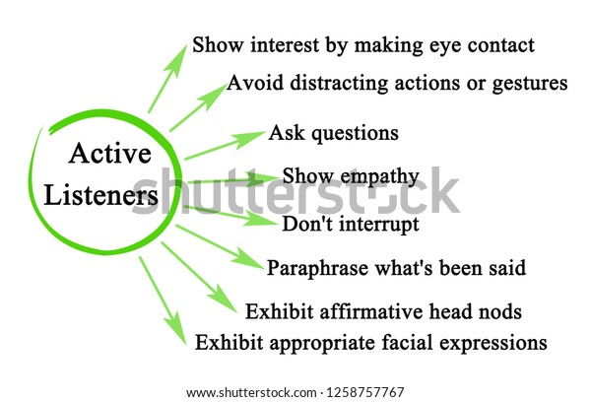

Slide 11
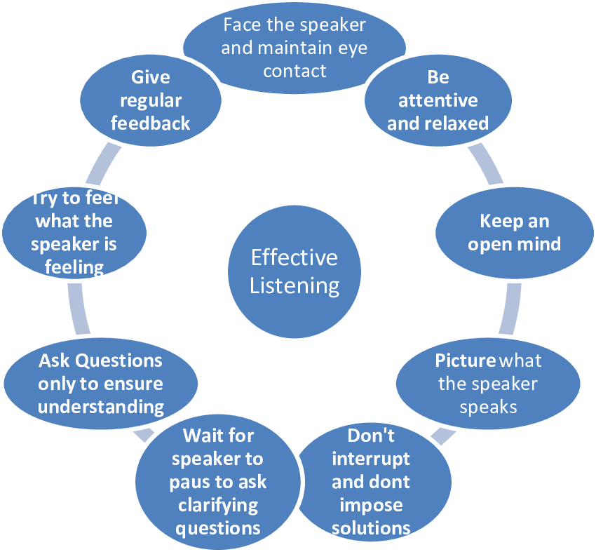

Slide 12
References
https://careers-in-sport.co.uk/career-advice/developing-effective-listening-skills/
https://www.shutterstock.com/image-illustration/eight-barriers-active-listening-1986212948
https://www.shutterstock.com/image-illustration/characteristics-active-listeners-1258757767
https://hildakweisburg.com/2018/08/11/on-libraries-build-your-listening-skills/
https://www.pinterest.com/pin/451485931380213512/

Slide 13
Thank you

